Slide 1

Deduplication and
Data Linkage
Todd Abraham
Iowa State University

Slide 2

Deduplication
Removing Redundant Records
Exact vs. Partial Redundancy
Issues for Data Quality
Noisy Record Linkage

Slide 3
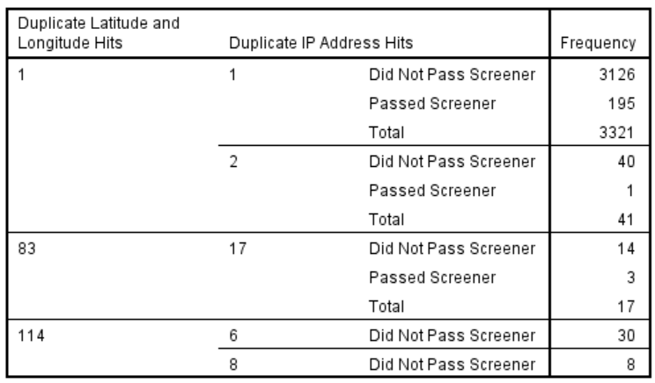
Amazon MTurk
Age 45+
Screener
US IPs
10,464 Hits
Location
Device
Time Stamps

Slide 4
Recall Data Structures
Single-Record Systems
Duplication Likely Administrative Errors Deduplicate by ID
Longitudinal-Record Systems
Duplication = Over-counting (Noise) Deduplicate within ID
Multiple-Record Systems
Over-counting Deduplicate within
Preservation of ID keys Identifier sets

Slide 5
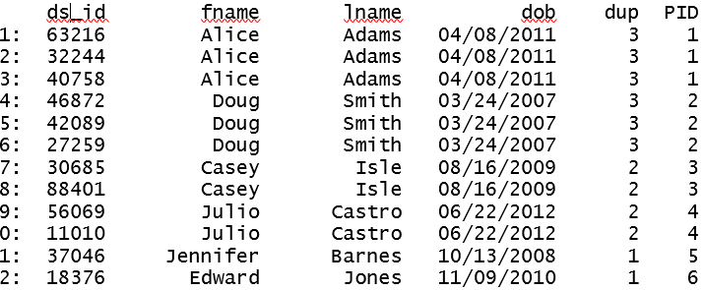
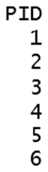
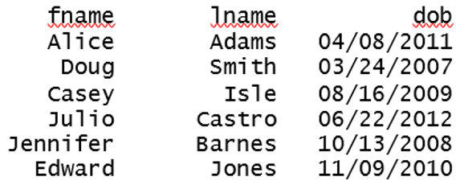
Deduplication By ID
Straightforward Removal of Repeated Records
Original File
Deduplicated File

Slide 6
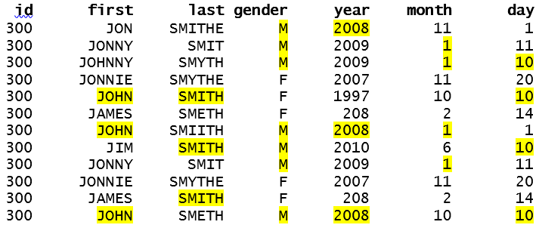
Deduplication Within ID
Straightforward if Exact Duplication – What if it’s Not?
Original File
Deduplicated File

Slide 7
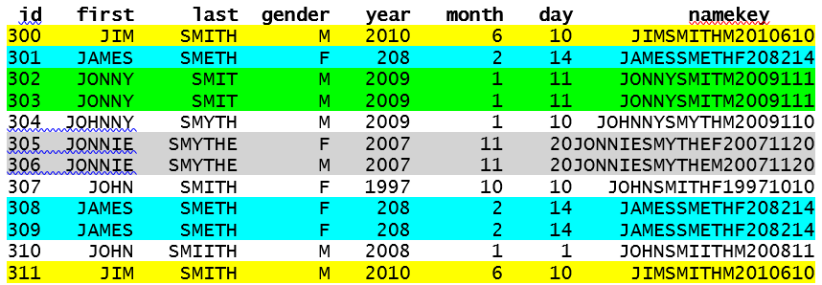
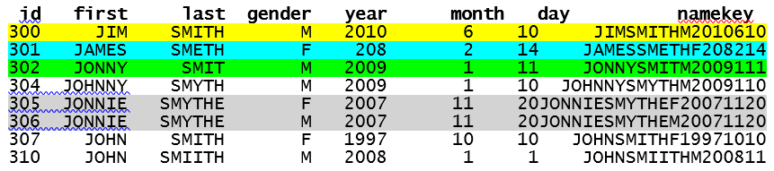
Deduplication Within Identifier Sets
Original File
Deduplicated File

Slide 8
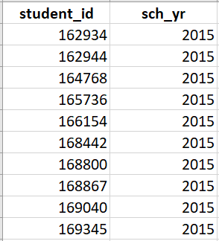
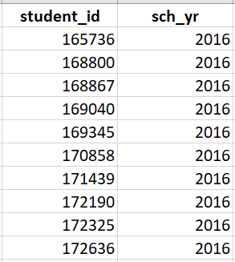
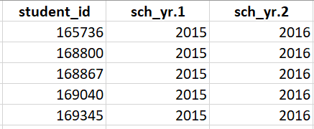
Multi-System Identifiers
Allow for Direct Matching Across Systems
SSN – What Others?
Matching is Deterministic

Slide 9
Differential System Identifiers
Direct Matching is not Possible across Systems
SSN ≠ Student ID
Birth record ≠ SSN
System-Specific ID = ???
Deterministic Matching by Identifier Sets?
Names = Names? (William = Bill) (Abigail = Abby)
Birth Dates = Birth Dates? (No They Don’t!)

Slide 10
Probabilistic Matching
How Similar are Records?
Names ≈ Names? (Jennifer ≈ Jenny) (Lucas ≈ Luke)
Dates ≈ Dates? (2011-04-07) (2012-04-07) (2011-04-17)
Two Probabilities
m: Reliability of the Data (Quality - Accuracy)
u: Commonality of the Data (uniqueness)

Slide 11
Conceptual Overview
Field Weights
Differential Weighting of Agreement/Disagreement
Based on m Probabilities
High Data Quality (Accuracy)
Mismatch between Two Records = High Likelihood of Mismatch
Match between Two Records ≠ High Likelihood of Match (necessarily)
Gender (50/50) Birth Year (33/33/33) Birth Month (1/12)

Slide 12
String Metrics
Soundex
Phonetic Codes for Approximate Homophones
Not Terribly Precise

Slide 13
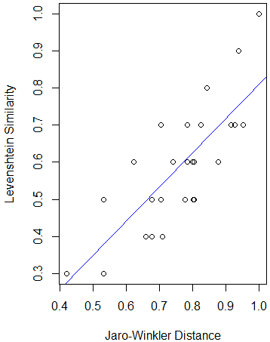
String Metrics (cont.)
Levenshtein Similarity
Insertions, deletions, substitutions
String 1 = String 2
Lidia Linda = .60 Lydia Linda = .40
Jaro-Winkler “Distance” (Similarity)
Transpositions between Strings
Weight on Start of Strings
Lidia Linda = .89 Lydia Linda = .76

Slide 14
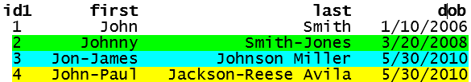
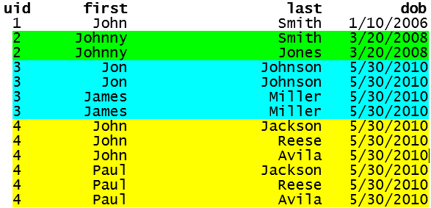
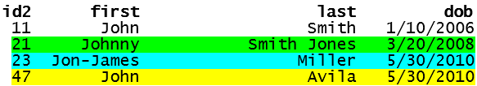
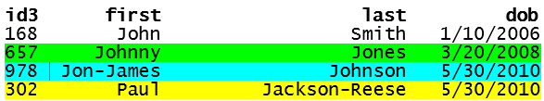
Practical Problems
Multiple (Compounded) Names
Original Files
Split File (Source 1)

Slide 15
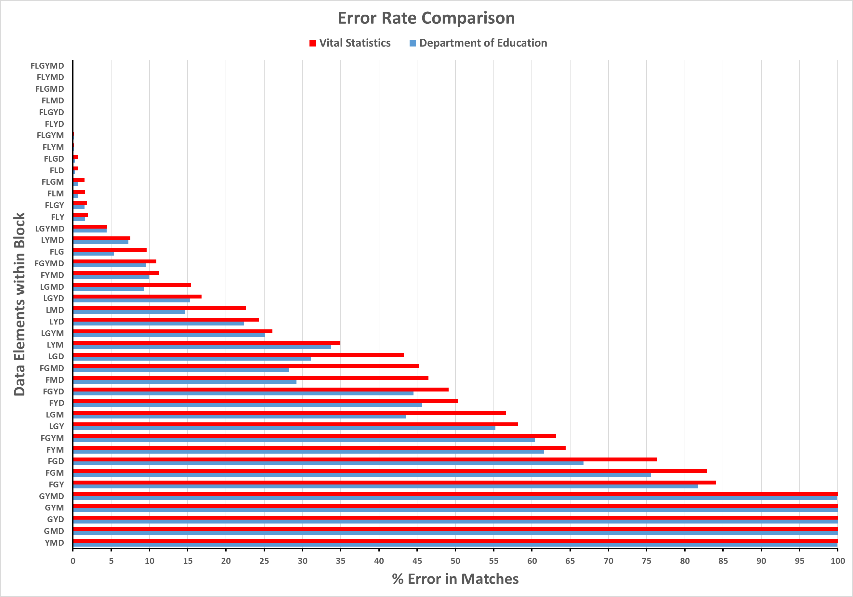
False Positives
Incorrect Matches
Full Match (0%)
DOB (100%)

Slide 16
False Negatives
Missing Correct Matches
Can’t Catch ‘em All (but try to?)
Current Work
Systematic Biases
Anna Hernandez Garcia = Anna Lopez Garcia (JW = 1)
David Von Deese = David Von Hackler (JW = 1)
Order of Operations
HernandezGarcia ≠ LopezGarcia (JW = .63)
VonDeese ≠ VonHackler (JW = .74)

